Slide 1
Predicting Future Credits
By: Griffin Thurman, Brett Kuefler, and Hunter Weimar

Slide 2
Our Goals
Analyze
Analyze the Imperial credit data
Create
Create and tune multiple models to predict future credit data
Use
Use the most accurate model to forecast Imperial credits

Slide 3
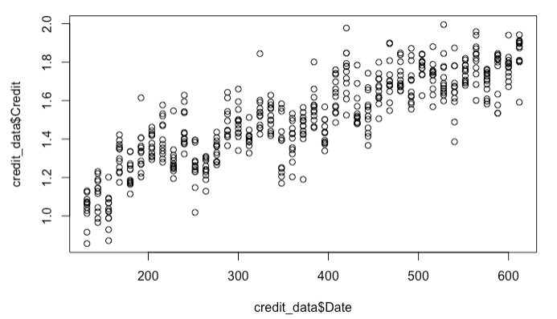
The Data
Had one field describing the credits received in millions
On average we received 1.57 million credits per month
A column was added to track the date of credits
Credits have seen a monthly steady increase
Credit In Millions
Month #

Slide 4
Model of choice
We created Neural Network, Exponential Smoothing, and ARIMA models.
The “best” model is the model to form the most accurate predictions
We chose the ARIMA model which made predictions that with a 10.6% error
Our model makes correct predictions 89.4% of the time

Slide 5
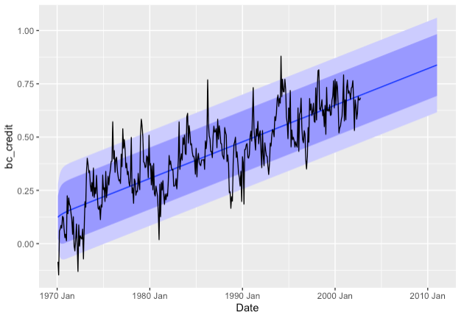
Predictions
Forecast shows a very steady increase in credits
We predict to gain 20.97 million credits over the next 12 months
The final predicted month is expected to be 1.90 times higher than the first month in our credit data.
Scaled Credits

